Slide 1
Gaussian Naive Bayes

Slide 2
The task of classification
What we have: the features, the labels - classes
What we need to find: a model to predict the class for given features
Formally, we require θ (parameters), such that, we can find y = c_{i} for a given row x

Slide 3

What we need to maximise

Slide 4
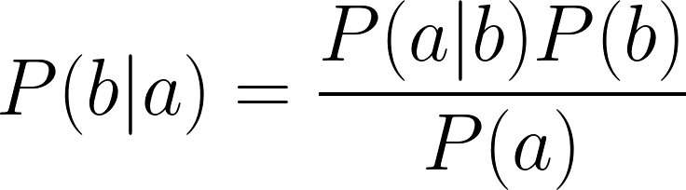
Bayes’ Rule
Prior Probability
Likelihood
Posterior Probability
Marginal Likelihood

Slide 5
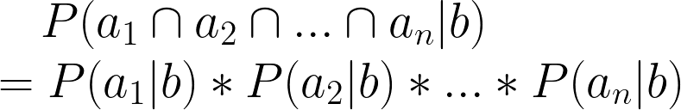
Naive Assumption
In reality, the likelihood term will contain many more interdependent variables
We choose to treat them as independent so that we will have a much simpler result. The probabilities simplify into product.

Slide 6
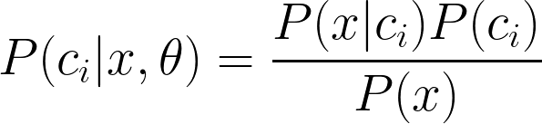
Naive Bayes
Calculation for each class
During classification

Slide 7

Gaussian Naive Bayes
In Gaussian Naive Bayes, we assume the Likelihood to follow a Gaussian Distribution

Slide 8
Logistic Regression

Slide 9
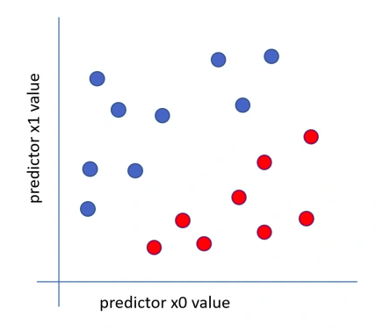
Somehow, a Linear Model for Classification

Slide 10
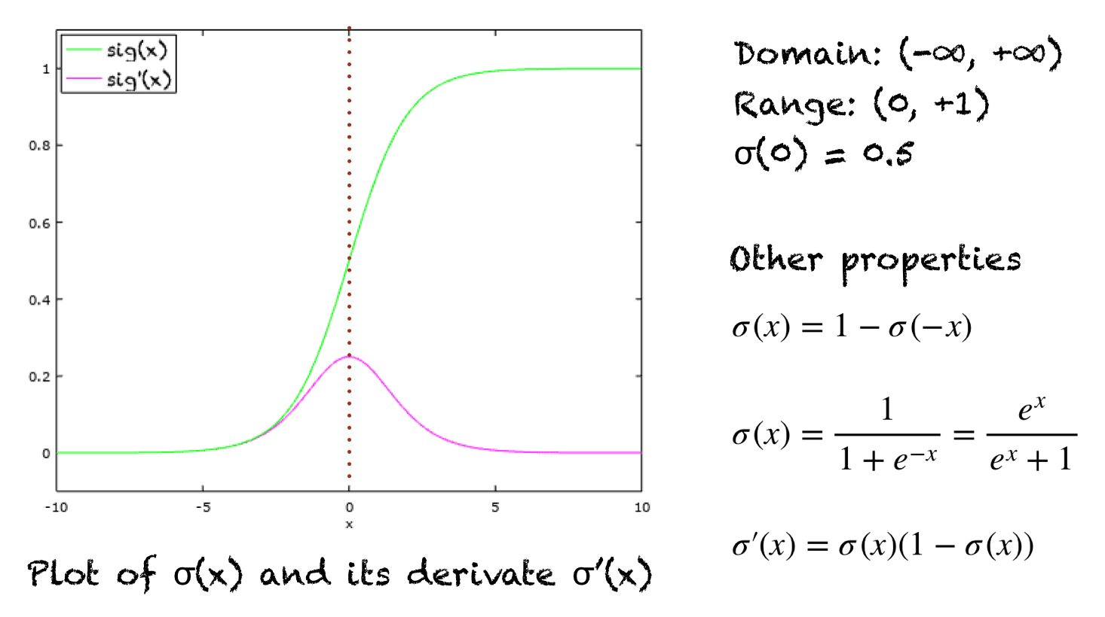
Sigmoid function

Slide 11

Logistic Regression
W^{T}x + b
W^{T}x + b < 0
W^{T}x + b > 0

Slide 12

Loss Function: Cross Entropy Loss
Binary Cross Entropy Loss:
Cross Entropy Loss:

Slide 13
K Means

Slide 14
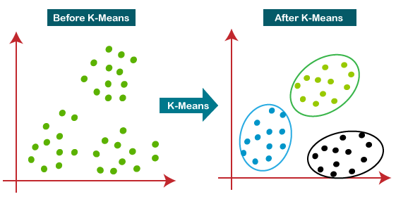
Objective: Clustering
Ref

Slide 15
Stepping towards clusters
Step-1: Select the number K to decide the number of clusters.
Step-2: Select random K points or centroids.
Step-3: Assign each data point to their closest centroid, which will form the predefined K clusters.
Step-4: Calculate the variance and place a new centroid of each cluster.
Step-5: Repeat the third steps, which means reassigning each datapoint to the new closest centroid of each cluster.
Step-6: If any reassignment occurs, then go to step-4 else go to FINISH.

Slide 16
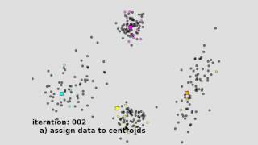
Stepping towards clusters

